Slide 1
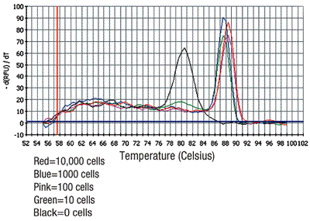
Statistical analysis for qPCR
Real-time PCR - a lab course
Ester Feldmesser
January 2023

Slide 2
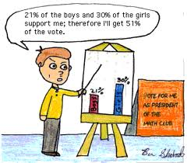
Why do we need statistical analysis for qPCR?
We have biological replicates
We want to know if gene expression differences between test samples are real (significant)
 |  | Avg dCt | dCt Std Err
Biol rept 1 | H1 | 12.581 | 0.025
 | H2 | 6.996 | 0.157
Biol Rept 2 | H1 | 12.12 | 0.033
 | H2 | 7.2 | 0.16
Biol Rept 3 | H1 | 13.1 | 0.031
 | H2 | 7.3 | 0.14

Slide 3
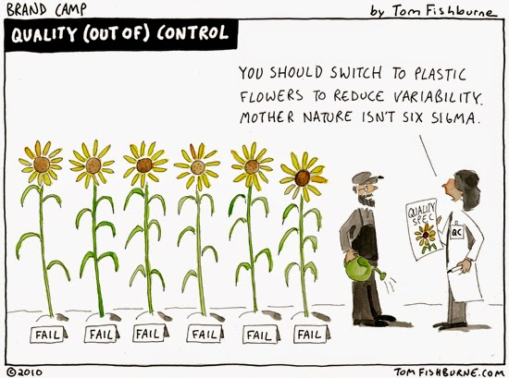
Sources of variability in experiments

Slide 4
Accumulation of Noise
Biological Variation (medium ,cell, conditions, etc.)
RNA Extraction
“Master mixes”
reaction pipetation
ε
Random error
Measurement
variation
Quantification

Slide 5

Characterizations of measurement
Accuracy
Inaccurate (biased)
Accurate (unbiased)
Imprecise
Noisy data
Precision
Precise
Little noise
Accuracy – Unbiased measurement _close to true value
Precision – Reproducible measurement_close to each other

Slide 6
Categories of variability
  Systematic variability (accuracy)
    Similar effects on many measurements
    Corrections can be estimated from data
    CALIBRATION is the general name for processes that correct for systematic variability
  Random variation (precission)
    Random effects cannot be estimated, “noise”
    EXPERIMENTAL DESIGN can help to deal with random variation
-amount of RNA in the biopsy
-efficiencies of
RNA extraction
reverse transcription
photodetection
-PCR yield
-RNA quality
-pipetation
-cross/unspecific priming

Slide 7
Analyzing the results
Convert the intensity values to log 2.
Why?

Slide 8
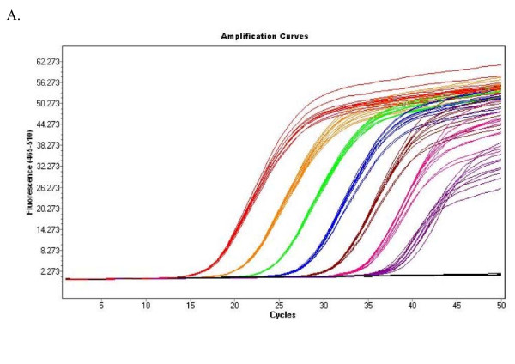
Examination of the raw data

Slide 9
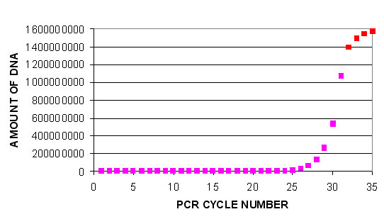
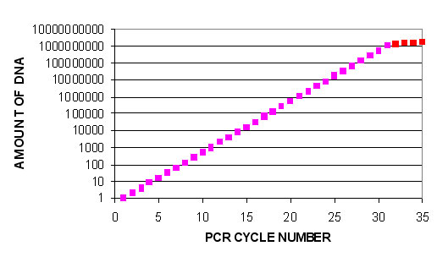
Is my data linear or in log2 scale?
The y axis is fluorescence, the scale is linear, but the graph exponential (in most of its range)
The y axis is fluorescence, the scale is logarithmic, but the graph linear (in most of its range)
http://pathmicro.med.sc.edu/pcr/realtime-home.htm

Slide 10
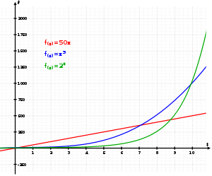
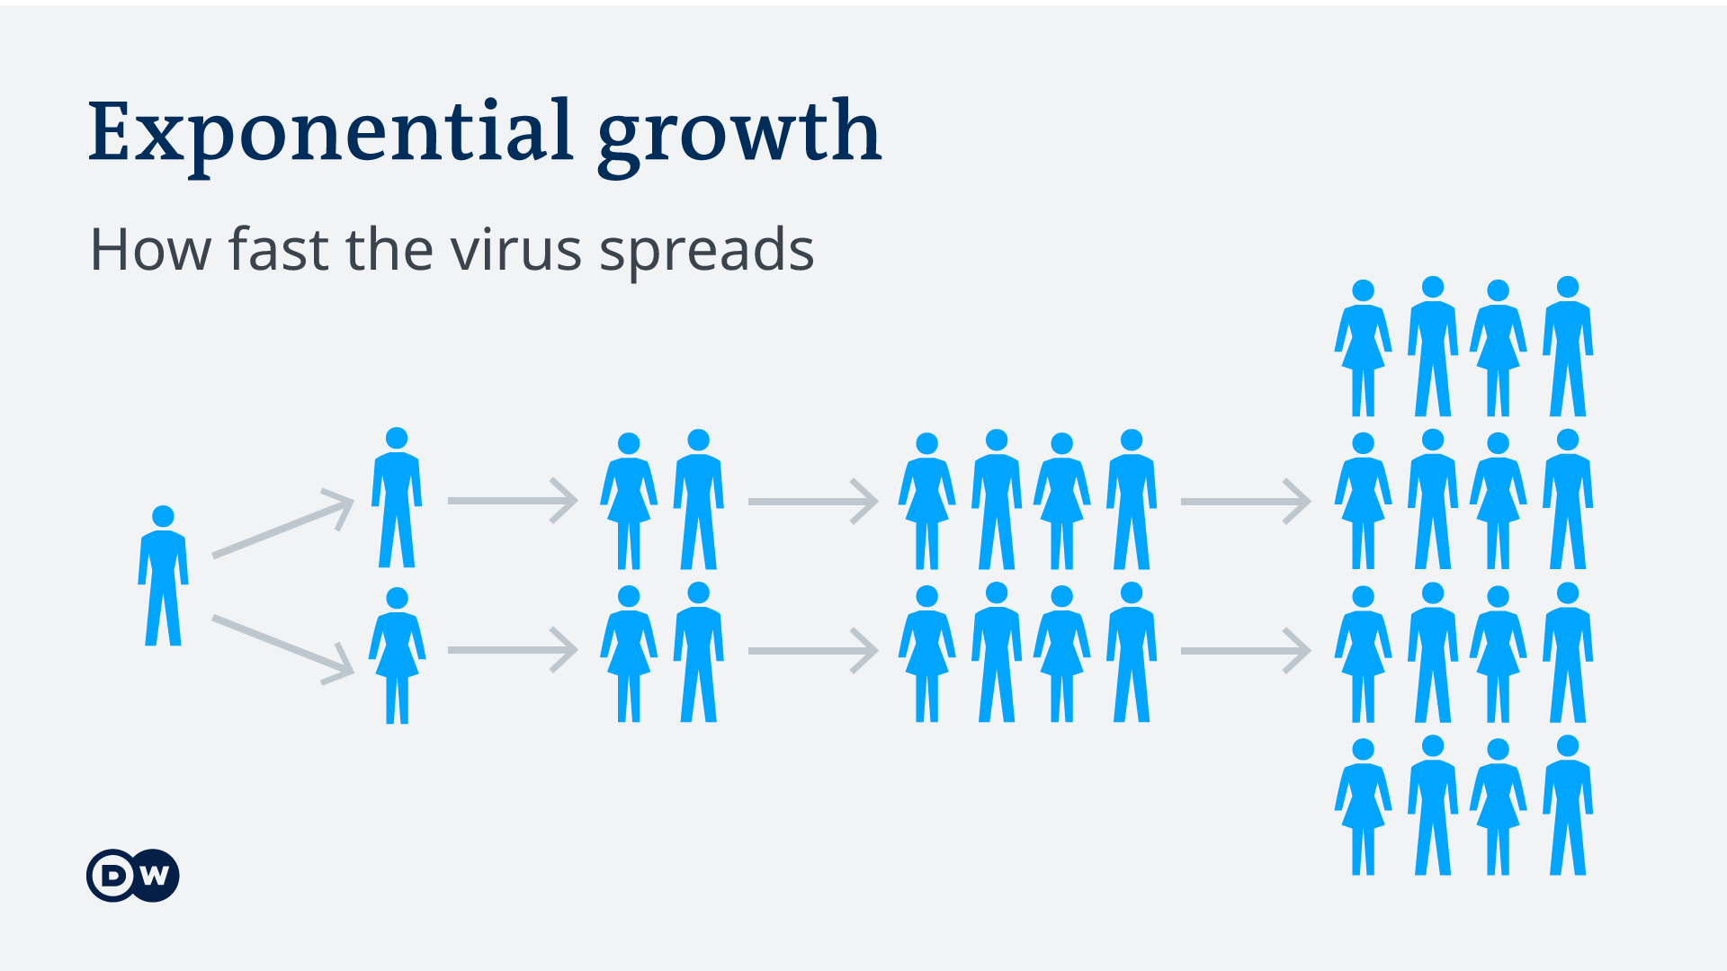
Exponential growth
Exponential growth occurs when the growth rate of a function is proportional to the function's current value.
The graph illustrates how exponential growth (green) surpasses both linear (red) and cubic (blue) growth.
2¹
2²
2³
2⁴
Examples
  The number of microorganisms in a culture broth will grow exponentially until an essential nutrient is exhausted. Typically the first organism splits into two daughter organisms, who then each split to form four, who split to form eight, and so on.
  A virus (for example SARS, or smallpox) typically will spread exponentially at first, if no artificial immunization is available. Each infected person can infect multiple new people.
http://en.wikipedia.org/wiki/Exponential_growth

Slide 11
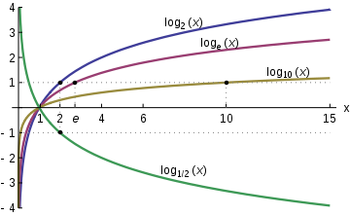



Logarithm
The logarithm of a number is the exponent to which a given base must be raised to produce that number. For example, the logarithm of 1000 to base 10 is 3,
because 3 factors of 10 multiply to a thousand:
10 × 10 × 10 equals 1000. The logarithm of x to base b is written log_{b}(x), so log₁₀(1000) = 3.
Logarithm functions, graphed for bases 2, e, 10, and 1/2.
The logarithm is the inverse of the exponential function.
Reminder on calculations with logarithms

Slide 12
Why to work with log2 values?
To build a linear standard curve
To appreciate fold changes more easily
To make the data distribution more symmetric, attributing equal weight to conditions with overexpression or underexpression
It is good for further statistics (normal distribution and equal standard deviations for all values)

Slide 13
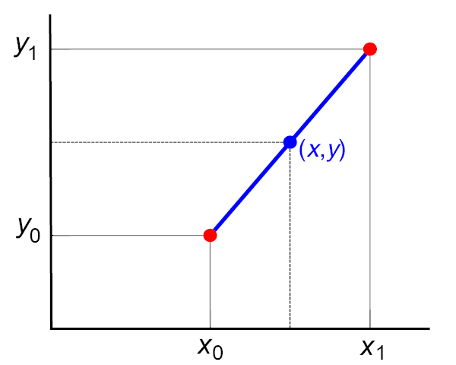


Linear interpolation
Given the two red points, the blue line is the linear interpolant between the points, and the value y at x may be found by linear interpolation.
If the two known points are given by the coordinates and , the linear interpolant is the straight line between these points. For a value x in the interval , the value y along the straight line is given from the equation
which can be derived geometrically from the figure on the right.
Solving this equation for y, which is the unknown value at x, gives
http://en.wikipedia.org/wiki/Linear_interpolation

Slide 14
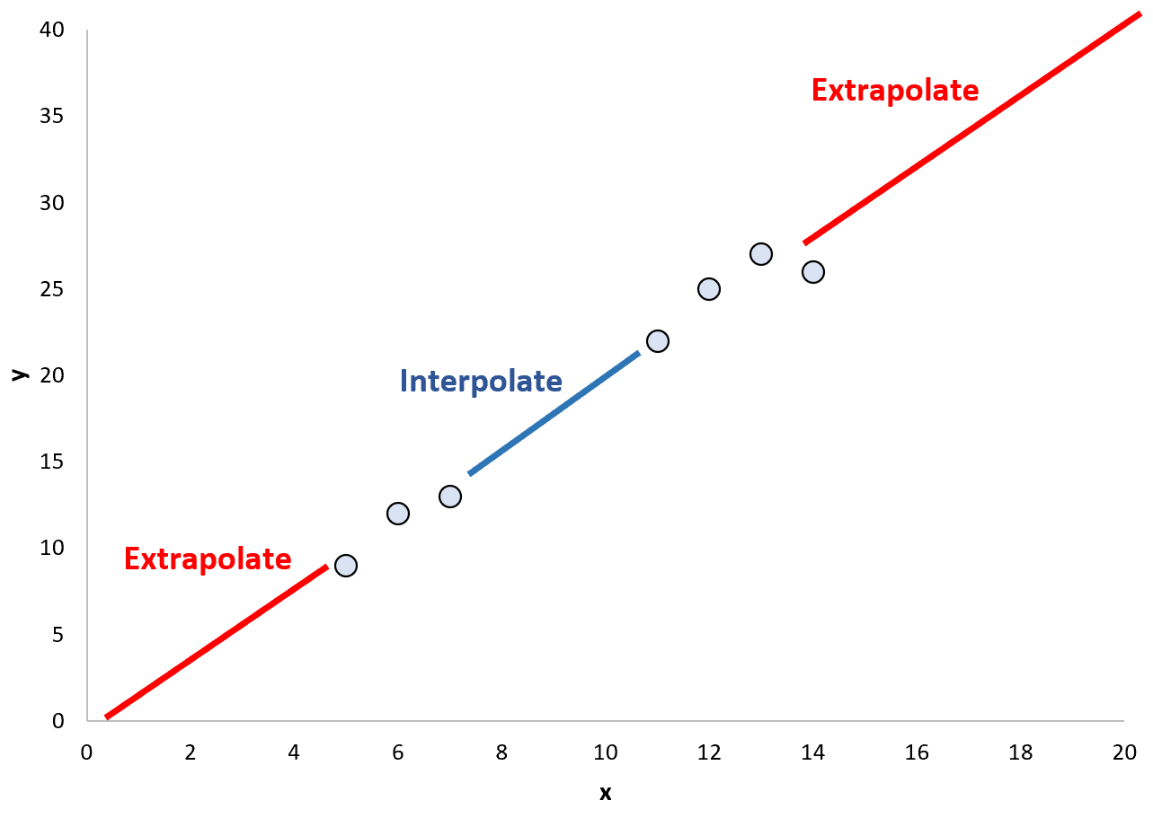
Can we extrapolate?

Slide 15
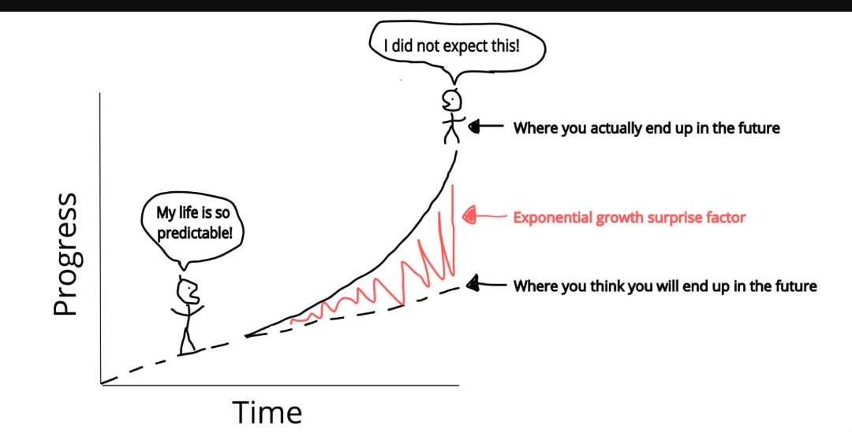
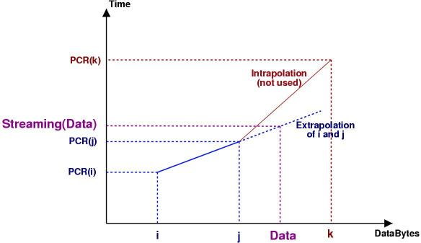
Linear extrapolation
Linear extrapolation means creating a tangent line at the end of the known data and extending it beyond that limit. Linear extrapolation will only provide good results when used to extend the graph of an approximately linear function or not too far beyond the known data.
http://www.sfr-fresh.com/unix/privat/vls-0.5.6.tar.gz:a/vls-0.5.6/doc/developer/extrapolation.jpg

Slide 16

Normalization
Why do we need to normalize ?
How do we normalize?
Comparing Apples & Oranges

Slide 17


Using multiple reference genes
How to calculate the mean:
Geometric mean
The geometric mean is more robust and less influenced by outliers than the arithmetic mean
Be careful when applying it: remember whether your data is already log transformed
According to the log calculation rules
log(a)^{1/n} = (log a)/n
log(a₁.a₂) = log a₁+log a₂
a

Slide 19
Is my data linear or in log2 scale?(2)
Threshold cycle (Ct) - The fractional cycle number at which the fluorescence passes the threshold
Ct (threshold cycle) is the intersection between an amplification curve and a threshold line, cycles are always in log2 scale regarding concentration (fluorescence), the parameter being measured in the experiment. Therefore ΔCt, and ΔΔCt are in the log scale and do not need to be transformed
Rn - Normalized reporter is the ratio of the fluorescence emission intensity of the reporter dye to the fluorescence emission intensity of the passive reference dye
ΔRn is the normalization of Rn obtained by subtracting the baseline: (ΔRn = Rn – baseline)
Rn and ΔRn are measured in linear scale fluorescence and need to be log2 transformed
http://www3.appliedbiosystems.com/cms/groups/mcb_marketing/documents/generaldocuments/cms_053906.pdf

Slide 20
Example 1
Using mean of relative quantitative values:
Biological replicate |  | Bip | SD | GAPDH | SD | Bip/GAPDH | SD
A | 100% glucose | 0.164627 | 0.009676 | 1.519475 | 0.002174 | 0.108345* | 0.006368
 | 10% glucose | 0.122026 | 0.001624 | 0.719877 | 0.007602 | 0.169509 | 0.002256
 | 2% glucose | 0.93232 | 0.065872 | 0.769879 | 0.003973 | 1.210995 | 0.085562
 | 0% glucose | 1.73961 | 0.118954 | 0.942278 | 0.01605 | 1.846175 | 0.126241
 |  | Bip | SD | GAPDH | SD | Bip/GAPDH | SD
B | 100% glucose | 0.208426 | 0.002596 | 1.577628 | 0.016894 | 0.132114 | 0.001646
 | 10% | 0.192545 | 0.003217 | 0.838849 | 0.002943 | 0.229535 | 0.003835
 | 2% | 0.702479 | 0.027186 | 0.780749 | 0.014051 | 0.899751 | 0.03482
 | 0% | 1.802799 | 0.127881 | 0.69095 | 0.008196 | 2.609159 | 0.18508
 |  | Bip | SD | GAPDH | SD | Bip/GAPDH
C | 100% glucose | 0.305998 | 0.001563 | 1.124385 | 0.004271 | 0.272147
 | 10% | 0.234082 | 0.008136 | 0.704636 | 0.014842 | 0.332203
 | 2% | 2.646081 | 0.138972 | 0.641357 | 0.000276 | 4.125754
 | 0% | 4.256526 | 0.043125 | 0.774534 | 0.001236 | 5.495596
A B C – Biological repeats
* See the conversion to log2 in the next slide

Slide 21
Example 1 - cont
To calculate ANOVA, extract log2 of the ratio Your Gene/Internal Control (Bip/GAPDH) and prepare a table as follows:
 | 100% glucose (calibrator) | 10% | 2% | 0%
A | -3.2063 | -2.56056 | 0.276193 | 0.884539
B | -2.92015 | -2.12321 | -0.1524 | 1.383585
C | -1.87754 | -1.58986 | 2.044658 | 2.458275
A B C – Biological repeats
log ₂ 0.1083 = -3.2063
Prepare an excel file in the above format and perform statistical analysis: ANOVA

Slide 22
Example 2
Using delta Ct values ( the values are already log transformed):
 |  | Avg dCt | dCt Std Err
Biol rept 1 | H1 | 12.581 | 0.025
 | H2 | 6.996 | 0.157
Biol Rept 2 | H1 | 12.12 | 0.033
 | H2 | 7.2 | 0.16
Biol Rept 3 | H1 | 13.1 | 0.031
 | H2 | 7.3 | 0.14
Prepare an excel file in the format below and perform statistical analysis: t-test or ANOVA
 | H1 | H2
1 | 12.581 | 6.996
2 | 12.12 | 7.2
3 | 13.1 | 7.2

Slide 23
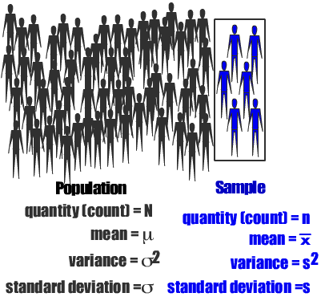
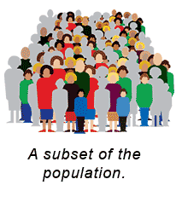
Population and sample
Sample: part of a population which is actually observed and represents all the entities of the population

Slide 24
Biological Replication
Replication is the repetition of an experimental condition so that the variability associated with the phenomenon can be estimated
Replication is not the same as repeated measurements (technical) of the same item: they are dealt differently in statistical experimental design and data analysis.
Examples?
http://en.wikipedia.org/wiki/Replication_(statistics)

Slide 25
Example
Let’s consider your samples. Measurements are conducted for each sample.
One sample is measured repeatedly to obtain ten test results. Only one sample was measured so there is no replication. The repeated measurements help identify observational error.
Ten samples might be taken from one replicate and each measured once. This is a technical replication because the ten samples are not random and not representative of all the possible experiments.
Five samples are taken from different biological replicates. These are processed in a batch and measured twice each. This includes technical and biological replication of the samples.

Slide 26
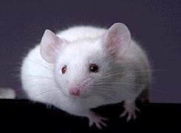
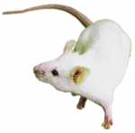


Example: technical & biological replicates
Individual
1
2
3
4
Tissue
RNA
Biological replicates
Technical replicates

Slide 27
Biological or technical replicate
Do biological replicates
Prepare new samples from new cultures
Remember to produce matched controls
DO NOT use technical replicates instead of biological ones (i.e. working on the same sample repeatedly)

Slide 28
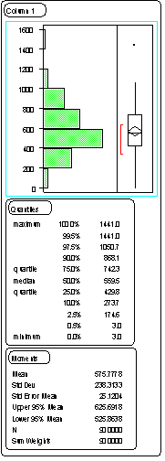
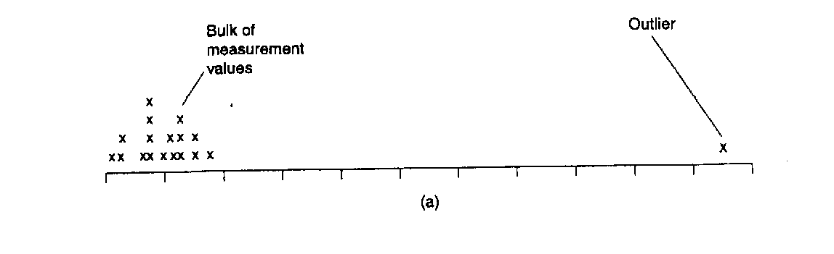
How many replicates?
Rule of thumb: At least three – to be able to detect outliers
One to convince yourself, one to convince your boss, one just in case...

Slide 29
To pool or not to pool?
Short answer is NO
Reasons to pool:
  Not enough RNA amount

Slide 30
How to pool?
cage1
cage2
cage3

Slide 31
How to pool?
cage1
cage2
cage3

Slide 32
How to pool?
cage1
cage2
cage3

Slide 33
How to decide?
Do you expect to have batch effect between the cages?
How many animals do you have in each cage?

Slide 34
Standard Deviation and Variance
Standard Deviation
The Standard Deviation (σ) is a measure of how spread out numbers are.
It is the square root of the Variance. So now you ask, "What is the Variance?"
Variance
The Variance (which is the square of the standard deviation, ie: σ²) is defined as:
The average of the squared differences from the Mean.
http://www.mathsisfun.com/standard-deviation.html

Slide 35



The formula for the variance in a population is
where μ is the mean and N is the number of scores.
When the variance is computed in a sample, the statistic
(where M is the mean of the sample) can be used. S² is a biased estimate of σ², however. By far the most common formula for computing variance in a sample is:
which gives an unbiased estimate of σ². Since samples are usually used to estimate parameters, s² is the most commonly used measure of variance. Calculating the variance is an important part of many statistical applications and analyses. It is the first step in calculating the standard deviation
The average of the squared differences from the Mean.
http://davidmlane.com/hyperstat/A16252.html

Slide 36
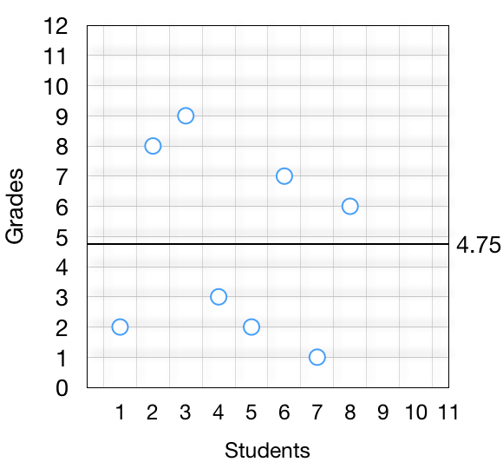
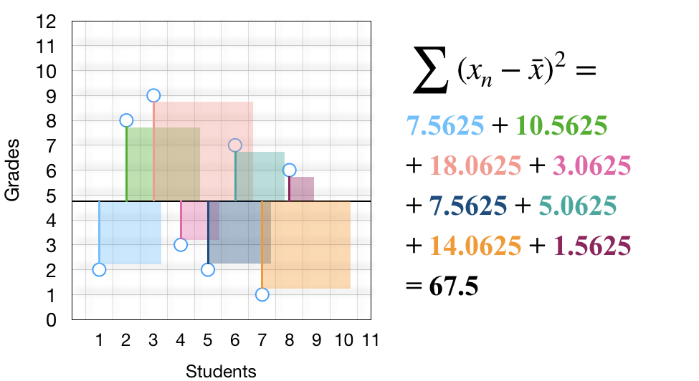
A visual interpretation of the standard deviation
As some differences are positive and some are negative, taking the sum will make negative numbers cancel out the positive ones ending up with zero (which does not mean anything).
To resolve this, we take the square of differences.
https://towardsdatascience.com/a-visual-interpretation-of-the-standard-deviation-30f4676c291c

Slide 37
*Note: Why square ?
Squaring each difference makes them all positive numbers (to avoid negatives reducing the Variance)
And it also makes the bigger differences stand out. For example 100²=10,000 is a lot bigger than 50²=2,500.
But squaring them makes the final answer really big, and so un-squaring the Variance (by taking the square root) makes the Standard Deviation a much more useful number

Slide 38

תודה

