Slide 1
DNA-seq and Variant calling
Analysis of DNA-seq data
Variant calling from short DNA reads.
Barak Markus
An Introduction to Deep-Sequencing 2015
Bioinformatics Unit, INCPM, WIS
June 2015

Slide 2
chromosome
fragments
Paired end sequencing
Two reads for each fragment

Slide 3
Inside the FastQ files
Read1 file lines 1-4
Seq ID
@HISEQ:117:H0U9GADXX:1:1101:1188:2075 1:N:0:ACAGTG
TCCTTGCGGCAGCTGAGTGACCCTGGGAGAGAGAAATTCATGATA …
+
CCCFFFFFHHHHHJJJJGIJJJJJJJJJIIIIIIIJIJIJJIJGIJJJJJIIIGGHHHEH …
Sequence
Quality
Read2 file lines 1-4
Seq ID
@HISEQ:117:H0U9GADXX:1:1101:1188:2075 2:N:0:ACAGTG
ATGTGTATATTGTAAAAGTACTTGGCTTACTCTGGAATTGCCTTCTG …
+
CCCFFFFFHHHHHJIJJJIHIJJJIJJJIIJJJJJJJJJJJIJJGIIJHGIIJIHEIIFGI …
Sequence
Quality

Slide 4
Inside the FastQ files
What information is in here and what is missing?
There is no location. What can you do with un-mapped reads?
Read2 file lines 1-4
Seq ID
@HISEQ:117:H0U9GADXX:1:1101:1188:2075 2:N:0:ACAGTG
ATGTGTATATTGTAAAAGTACTTGGCTTACTCTGGAATTGCCTTCTG …
+
CCCFFFFFHHHHHJIJJJIHIJJJIJJJIIJJJJJJJJJJJIJJGIIJHGIIJIHEIIFGI …
Sequence
Quality

Slide 5
Raw fastq files: Quality distribution

Slide 6
Raw fastq files: Quality distribution

Slide 7
Raw Fastq files - QC
FastQC
Quality scores
GC content
Over represented sequences
Duplication level (PCR)
Undetermined bases

Slide 8
The mapping process

Slide 9
chromosome
fragments
Paired end sequencing
Two reads for each fragment

Slide 10
chromosome
read1
read2
This is what we hope has happened!

Slide 11
chromosome
read1
read2
This is what we want:
Successful mapping
This is what we really have – our data!

Slide 12
chromosome
read1
read2
Things do not always map smoothly!

Slide 13
Mapping –zooming in
REFERENCE GENOME
AACTCGACAACGTGCACGTGCACGTG
AACTCGA
GCACGCG
READ1
READ2

Slide 14
Mapping –zooming in
REFERENCE GENOME
AACTCGACAACGTGCACGTGCACGTG
AACTCGA
GCACGCG
READ1
READ2
Perfect match

Slide 15
Mapping –zooming in
REFERENCE GENOME
AACTCGACAACGTGCACGTGCACGTG
AACTCGA
GCACGCG
READ1
READ2
Mismatch!
Do we accept this mapping?

Slide 16
Mapping –zooming in
REFERENCE GENOME
AACTCGACAACGTGCACGTGCACGTG
AACTCGA
GCACCCG
READ1
READ2
2 Mismatches!
Do we accept this mapping?

Slide 17
Mapping –zooming in
REFERENCE GENOME
AACTCGACAACGTGCACGTGCACGTG
AACTCGA
GCACG
READ1
READ2
INDEL!
Do we accept this mapping?

Slide 18
Mapping –zooming in
REFERENCE GENOME
AACTCGACAACGTGCACGTGCACGTG
AACTCGA
GCAC__G
READ1
READ2
INDEL!
Do we accept this mapping?

Slide 19
Mapping –zooming in
AAAAAAA
A___AAAAAA
REFERENCE GENOME
AACTCGACAACGAGCAAAAAAAAGCA
AACTCGA
AAAAAA__A
READ1
READ2
What-a-Mess!
Do we accept this mapping?

Slide 20
Mapping reads
85-90% map uniquely with the expected insert size
The rest is problematic
Reads mapped to different chr
Reads mapped to several locations
Reads not mapped at all!
Why?

Slide 21
Mapping reads
Mapping is intensive hence very few mismatches are allowed!
Examples
Repetitive regions
Homology
Indels (# of mismatches)
Contamination
Indels get special treatment!

Slide 22
Mapped reads

Slide 23
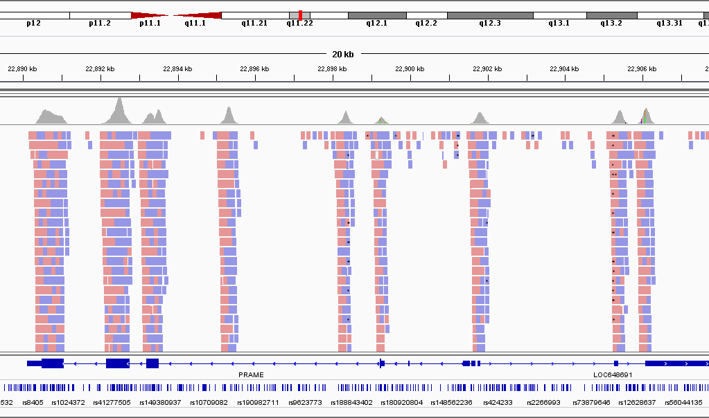
This is an Exome-Seq dataset!
Coverage
reads
Zooming in
Exon

Slide 24
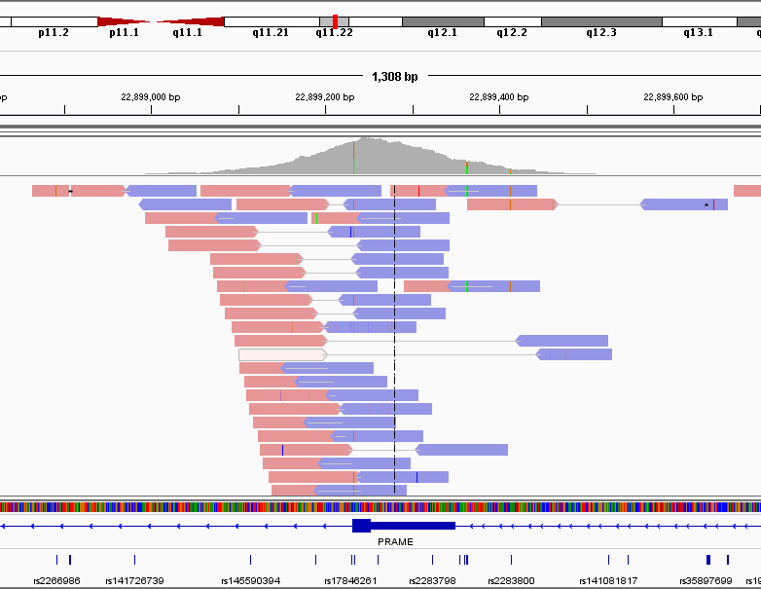
Diff from the Ref
read2
read1
Poor mapping
insert

Slide 25
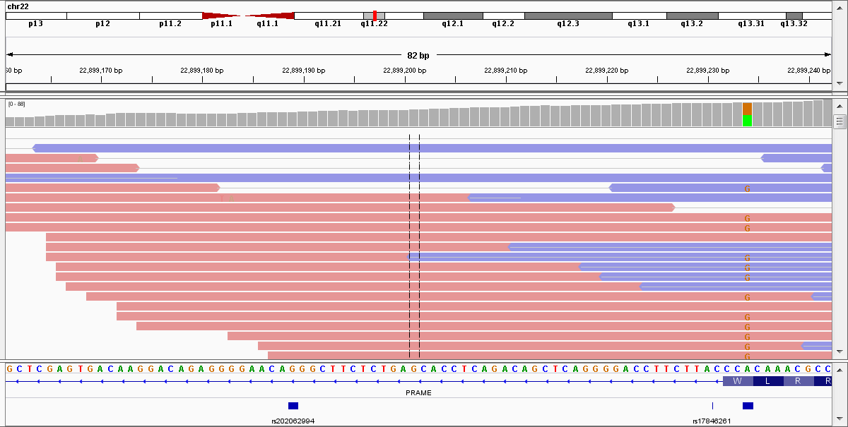
36 A
38 G
Why not 37A and 37G?
(hint: coin tossing)
Ref Genome
Known SNP

Slide 26
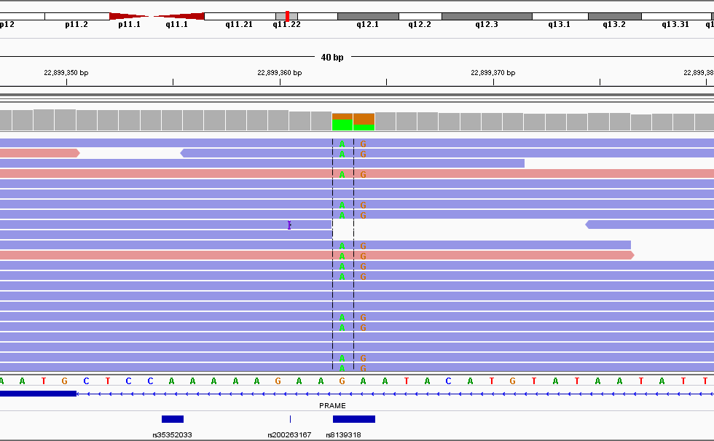
19 A
11 G
11 A
19 G

Slide 27
4 A
10 G
Het A/G ?
Coin flipping?
Is it known?
rs2283800 [Homo sapiens]
AACGGCCTCCTGTGAAAACCTCCGC[A/G]AATACTGCTGAGGAAACTGACAACT
Global MAF:A=0.3200/696

Slide 28
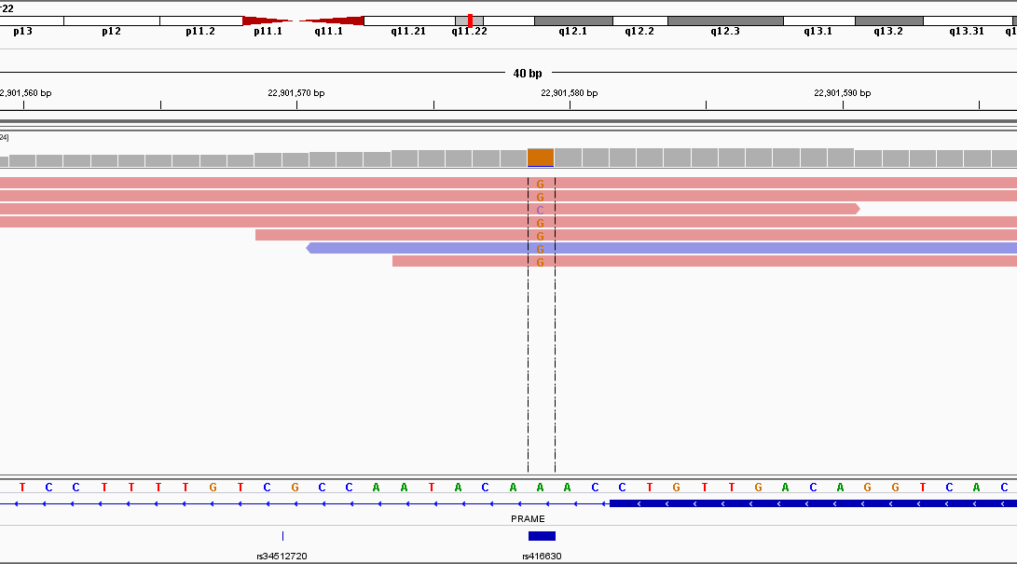
1 C
11 G
0 A (ref)
Het G/C ?
Coin flipping?
Why C ?
rs416630 [Homo sapiens]
GGCTGCTCCTTTTGTCGCCAATACA[A/G]ACCTGTTGACAGGTCACGCCTGGGA Global MAF:A=?/0

Slide 29
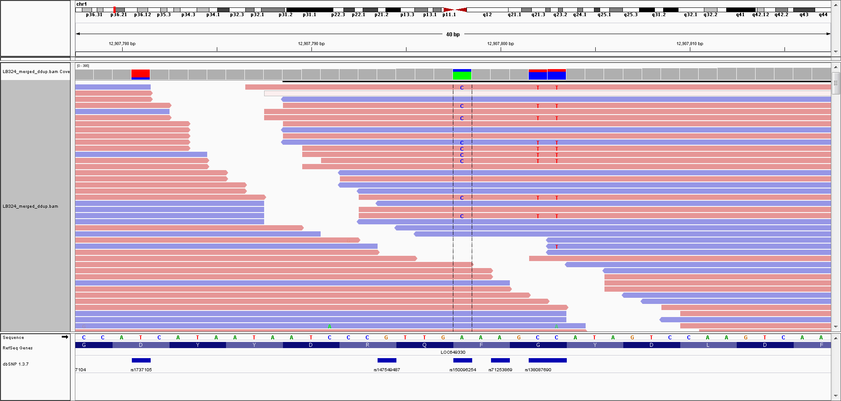
Total count: 246
A : 182 (74%, 91+, 91- )
C : 64 (26%, 61+, 3- )
G : 0
T : 0
N : 0
---------------
A 182
C 64
Allelic imbalance
A : ( 91+, 91- )
C : ( 61+, 3- )
Strand Bias

Slide 30
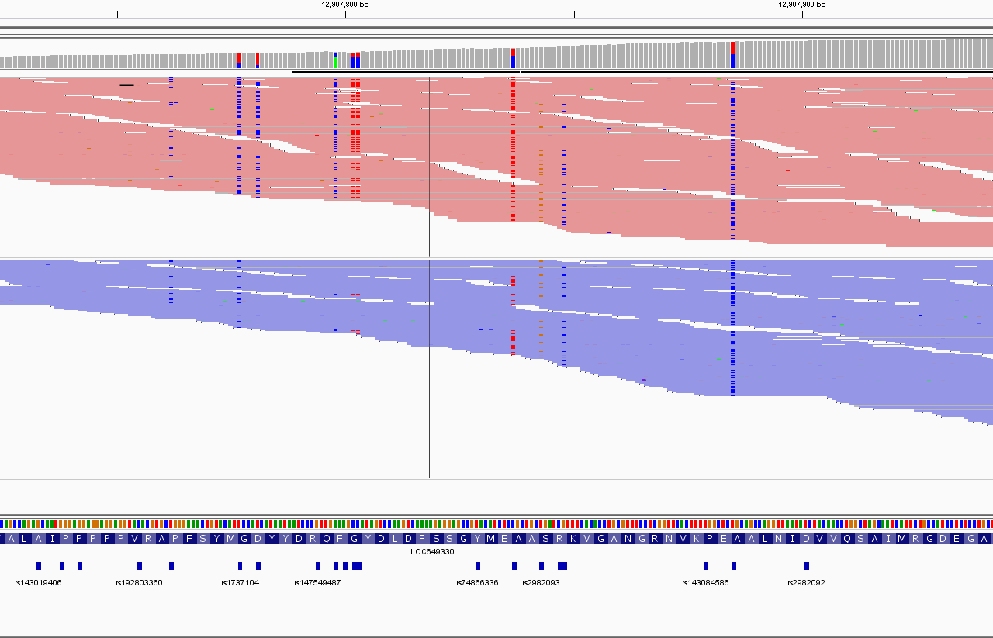
The signal will occasionally be imbalanced (like an imbalanced coin). Why?
Systematic noise looks like a real, non-random signal!
It is difficult to decide what is real and what is a systematic error?
+ reads
- reads
Low
AF
Strand
Bias
Low
AF
Real
SNP

Slide 31
Summary of variant filtering
Try to call everything which is different from the reference and then …
Detect systematic biases
Alt allele biases
Strand bias
Base Quality bias
Regional biases
Mapping quality
INDELS
etc…

Slide 32
Summary of pipeline
FastQC
Raw alignment
Removing PCR duplicates
INDEL re-alignment
Recalibration of quality scores
Variant calling (Naïve)
Variant filtration
Search: GATK best practices videos

Slide 33
Working with data
Hands on

Slide 34
VCF and BAM files
STEPS
Download the sample vcf file (it was exported to excel)
Load BAM file to IGV
For each variant in the vcf file try to figure out if it is real or an artefact.

Slide 35
VCF for the exercise
Understanding vcf files
http://gatkforums.broadinstitute.org/discussion/1268/how-should-i-interpret-vcf-files-produced-by-the-gatk
Download the output for a small region with selected variants: \\ngs001\Open_Data\Course2015-exercise1\dnaseq\vcf-exercise.xlsx

Slide 36
Phred scaled Qualities
Phred scaled probability: -10 * log(p)
All probabilities in the file are Phred scaled
Quality | Probability
10 | 0.1
20 | 0.01
30 | 0.001
40 | 0.0001

Slide 37
VCF files
QUAL: phred prob that there is NO variant in this locus on all samples
INFO: parameters and statistical tests that assess the quality of the reads in this locus (leave this for now …)
GENOTYPE: the genotype of an individual in the current locus
ID: is it known in the SNP databases

Slide 38
VCF files
Describing the most likely genotype …
GT | AD | DP | GQ | PL
0/1 | 50,34 | 80 | 99 | 1066,0,1295
PL = likelihoods ratios, Phred scaled
Most likely genotype is A/G.
The statistical “distance” to other genotypes is very large
Example: the Likelihood ratio between AA and AG is ~ 10^{-129.5}
GG | AG | AA
1066 | 0 | 1295

Slide 39
VCF and BAM files
STEPS
Download the sample vcf file (it was exported to excel)
Load BAM file to IGV
For each variant in the vcf file try to figure out if it is real or an artefact.

Slide 40
http://www.broadinstitute.org/igv/home
Need to register

Slide 41
Download according to your computer strength

Slide 43
Select genome hg19

Slide 44
Load sample BAM file
We will load from URL , under File select the option Load from URL.
Copy and paste using control-C and control-V
\\ngs001\Open_Data\Course2015-exercise1\dnaseq\NA12878.chr20.L30-40.bam

Slide 46
STEPS
Download the sample vcf file (excel format)
Load BAM file to IGV
For each variant in the vcf file try to figure out if it is real or an artefact.

Slide 47
Just before the end!
Variant calling is the end of a pipeline but just the start of the analysis. This means endless QC even after the variant calling has ended …
Example: QC for whole exome/genome sequencing in humans
Compare called and expected # variants
# SNPs (expected ~ 1/1000 bases). # INDELs (?)
How many expected/measured novel variants (not in dbSNP)?
What is the Ti/Tv ratio for known and novel?
More
http://bib.oxfordjournals.org/content/early/2013/09/24/bib.bbt069.full
http://gatkforums.broadinstitute.org/discussion/48/using-varianteval
And many others …

Slide 48
FIN
vcf, bam and solution here:
http://incpm-2.weizmann.ac.il/bioinfo/DeepSequencingAnalysis2014/DNA-Seq/

Slide 49
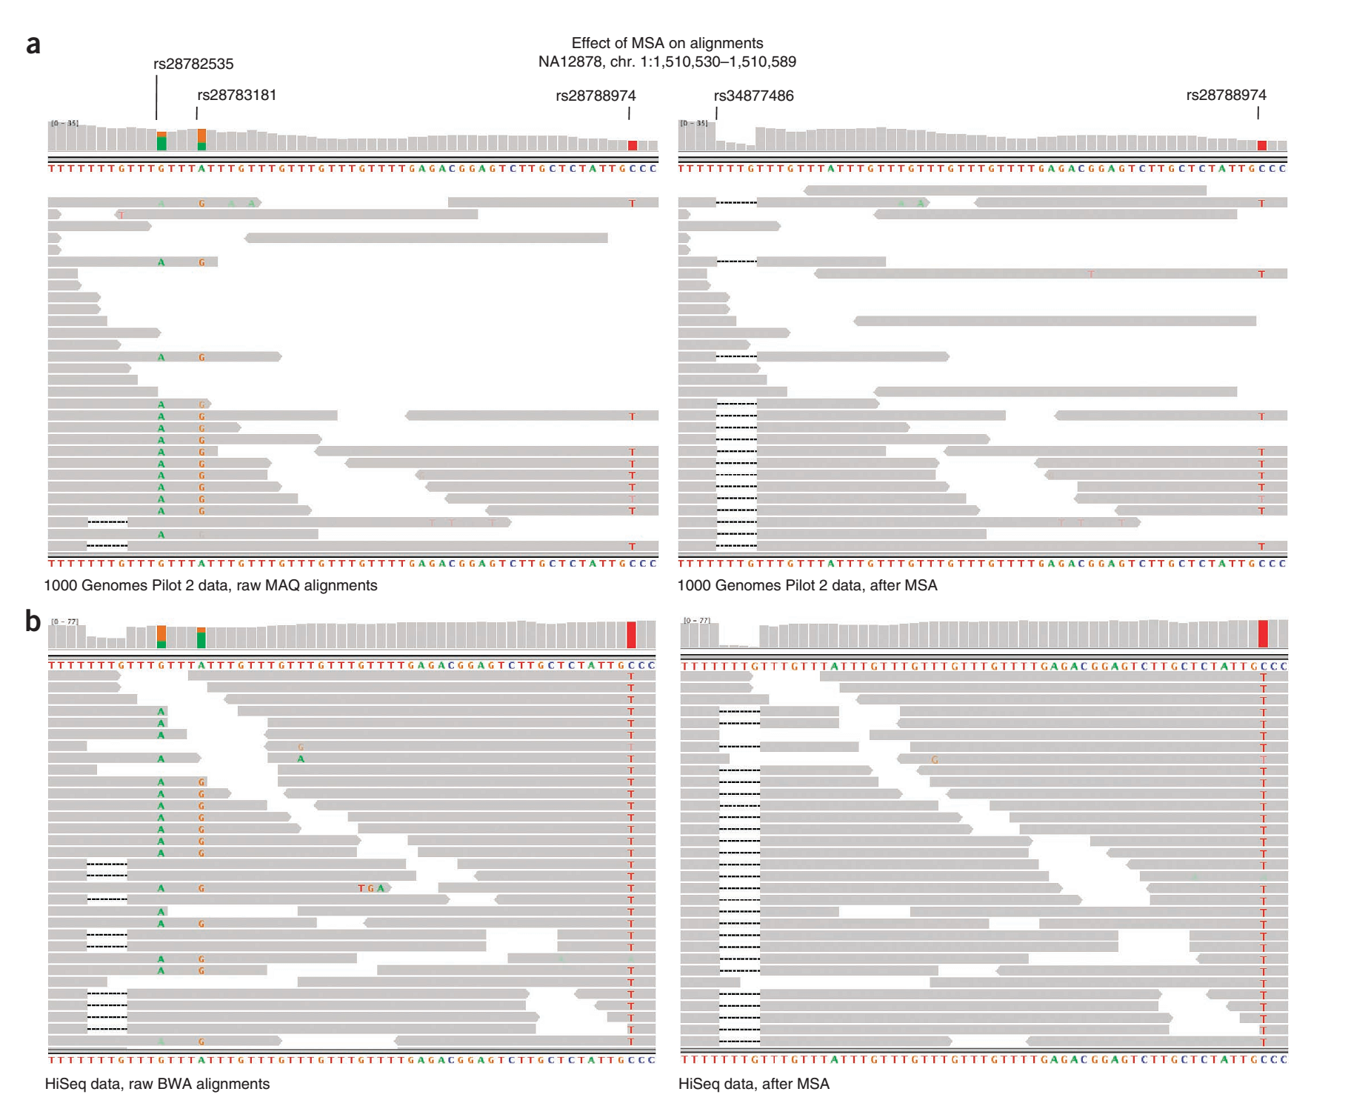
The effect of INDEL re-alignment on nearby SNP calling.
Before
After
GATK: DePristo et al. 2011

